Slide 1
Welcome all parents/grandparents/carers!
Please help yourself to tea, coffee and biscuits while we get the children registered. Ensure you have finished your hot drink when we arrive with the children at 9:00.
Please write your name next to your child’s name on the register by the urn.
Take a seat at the front.

Slide 2
Impact Workshop Year 4 Maths
Thursday 5th October 2017
Aim of the morning:
- Provide an overview of internet safety.
To provide you with some simple fluency games you can play at home.
To explain some of the mental strategies we use in school.
To show the formal written methods we use and the reasoning behind them.
E.R

Slide 3
E-safety Tips for Parents
Let them teach you…
The people who know best about what your children are up to online, are your children! Get them to tell you about the sites they’re using. Ask them questions such as:
Why do they like the site?
What can they do on it?
What’s so fun about it?
Who uses it at school?
Who you can talk to?
Who are their friends on it?
This is a good way to develop a trusting relationship with your child about what they are up to online.

Slide 4
Reach an agreement…
A good way to set boundaries with your child about what they can and can’t do online is to set an agreement with them.
Limits on the amount of time your child spends online, or playing computer games.
Having regular screen breaks – at least five minutes every 45-60 minutes.
Not sharing any pictures they wouldn’t be happy to share with you.
Not giving out personal details, such as mobile phone number and address, to people they don’t know and trust.
Coming to you if they are concerned. Or, if not, knowing where they can go for independent help and support.

Slide 5
SMART Rules
S = Safe
M = Meeting
A = Accepting
R = Reliable
T = Trustworthy

Slide 6
School website
Please have a look at the e-safety page on the school website. You will find lots of helpful tips and links to other pages that you may find useful.
http://www.hollyfield.bham.sch.uk/

Slide 7
Have a look at NSPCC Net Aware website or download the App
Your guide to the social networks your kids use
Stay up to date and keep your child safe in today's digital world

Slide 8
The three strands of the Maths Curriculum
Fluency
Problem solving
Reasoning
E.R

Slide 9
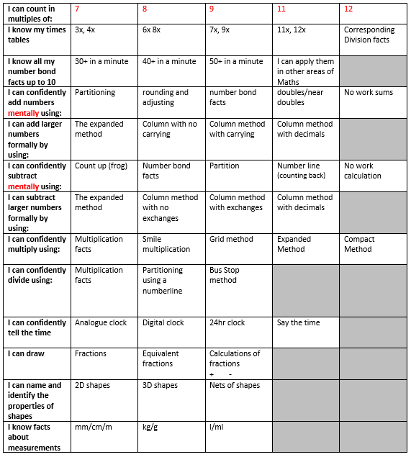

Slide 10
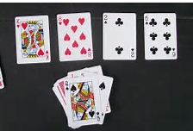
Games you can play at home
to build fluency
Take the jokers and the picture cards out.
Each player turns over a card. Each player must add them together as quickly as possible. The first person to shout out the answer keeps the cards.
The winner is the person with the most cards at the end or the person who ends up with all the cards.
To make it more challenging each player turns over 2 cards and adds them together. First to shout out the answer takes the cards.
Have ago and play with your children.
E.R

Slide 11
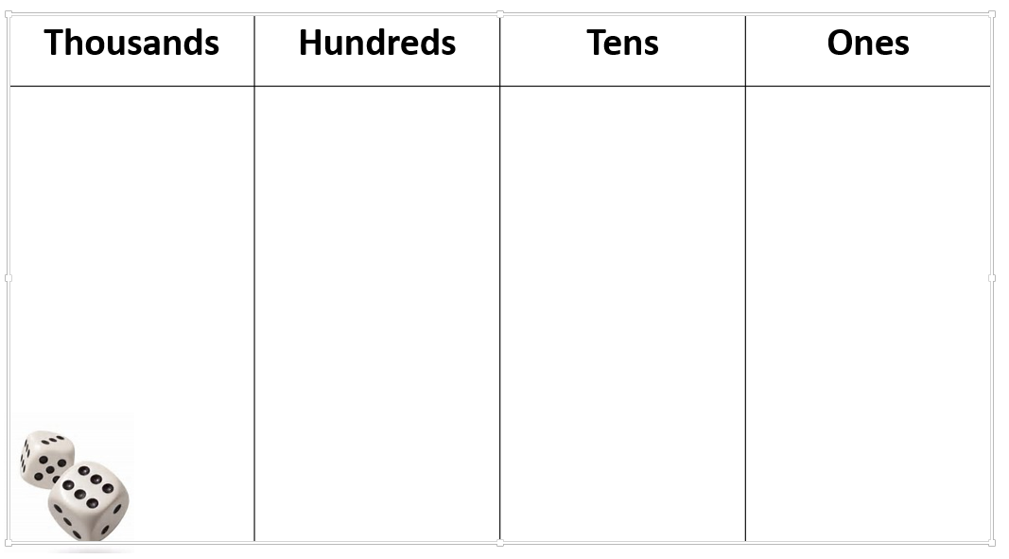
Aim of the game is to make the largest possible number.
Players take it in turns to roll the dice.
The player chooses where they will place that digit to help create the largest number and writes it on the grid.
Keep going till each player has a four digit number.
First to 5 wins.
Extra challenge- Find the difference between your number and your partners number.
E.R

Slide 12
16
Create one with your child:
Use this vocabulary:
Factors
Prime Number
Odd or even
10 times bigger
100 times bigger
It isn’t a prime number
It is even
Factors 1, 16 , 2,8 ,34
10 times bigger
160
100 times bigger
1600
E.R

Slide 13
Methods we use in school: Mental addition
These are the methods we teach and will be looking at today.
Ask your child to explain these methods to you:
Diamond method/partitioning
Rounding
Using number facts
The numbers choose the method you use!

Slide 14
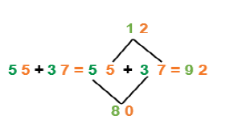
Diamond Method (partitioning)
– adding the 10s and 1s
Answer these questions with your child:
46 + 89=
39 + 67=
42 + 98=
Partitioning with jottings:
55 + 37 =
50 + 30 = 80
5 + 7 = 12
80 + 12 = 92

Slide 15
Rounding:
39 + 14 =
Easier to change 39 to the next 10.
To do this, we take 1 from 14 to make the following sentence:
40 + 13 =
Better to solve it this way!
Answer these questions with your child:
29 + 72 =
31 + 65 =
44 + 61 =
23 + 69 =

Slide 16
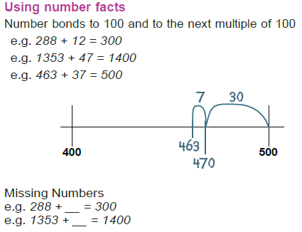
Number Bonds
Use your number bonds to 10, 20 and 100 to add to the next multiple of 10, 100 and 1000.
Answer these questions with your child:
44 + 124
88 + 65 =
83 + 66 =

Slide 17
Formal written addition
To help children better understand how to add using a column, we teach them the expanded method first:
This helps them understand why we carry digits to the next column.
1466 + 4868 = 6334
Answer these questions with your child:
5344 + 2124
1088 + 2365 =
E.R

Slide 18
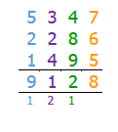
Written addition
When we then move onto the compact column method, we ensure children understand that they are adding digits in columns, so we no longer have to say 5000 + 2000 = 7000.
We just say 5 + 2 = 7, but we know what column they are in.
E.R

Slide 19
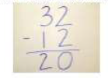
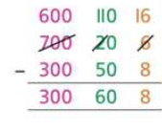
Column subtraction
At first, we use the column without regrouping. That means the numbers are easy to subtract.
We then move onto column subtraction with regrouping,
once again using the expanded method first. We call
‘regrouping’ stealing as the numbers won’t go back to
their original column. We always use resources when
we first teach column subtraction with stealing, so the
children understand why we steal from the next column.
E.R

Slide 20
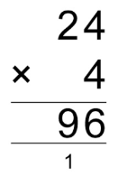
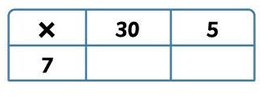
Written multiplication
35 x 7 =
35+35+35+35+35+35+35=
Try these using the grid method:
23 x 6 =
42 x 4 =
E.R

Slide 21
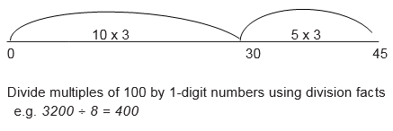
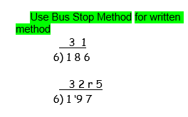
Formal Written Method Division
Chunking on a number line

Slide 22
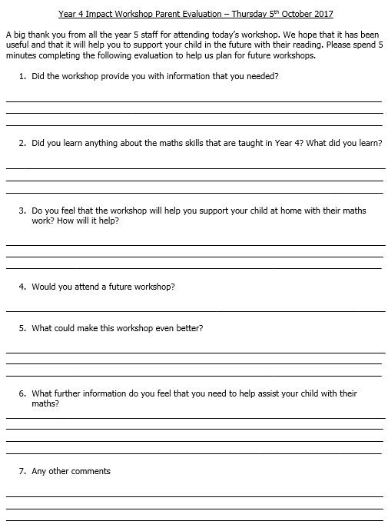
Thank you
Please take the time to fill in a parent evaluation form.
Feel free to ask any questions you might have.

